Slide 1

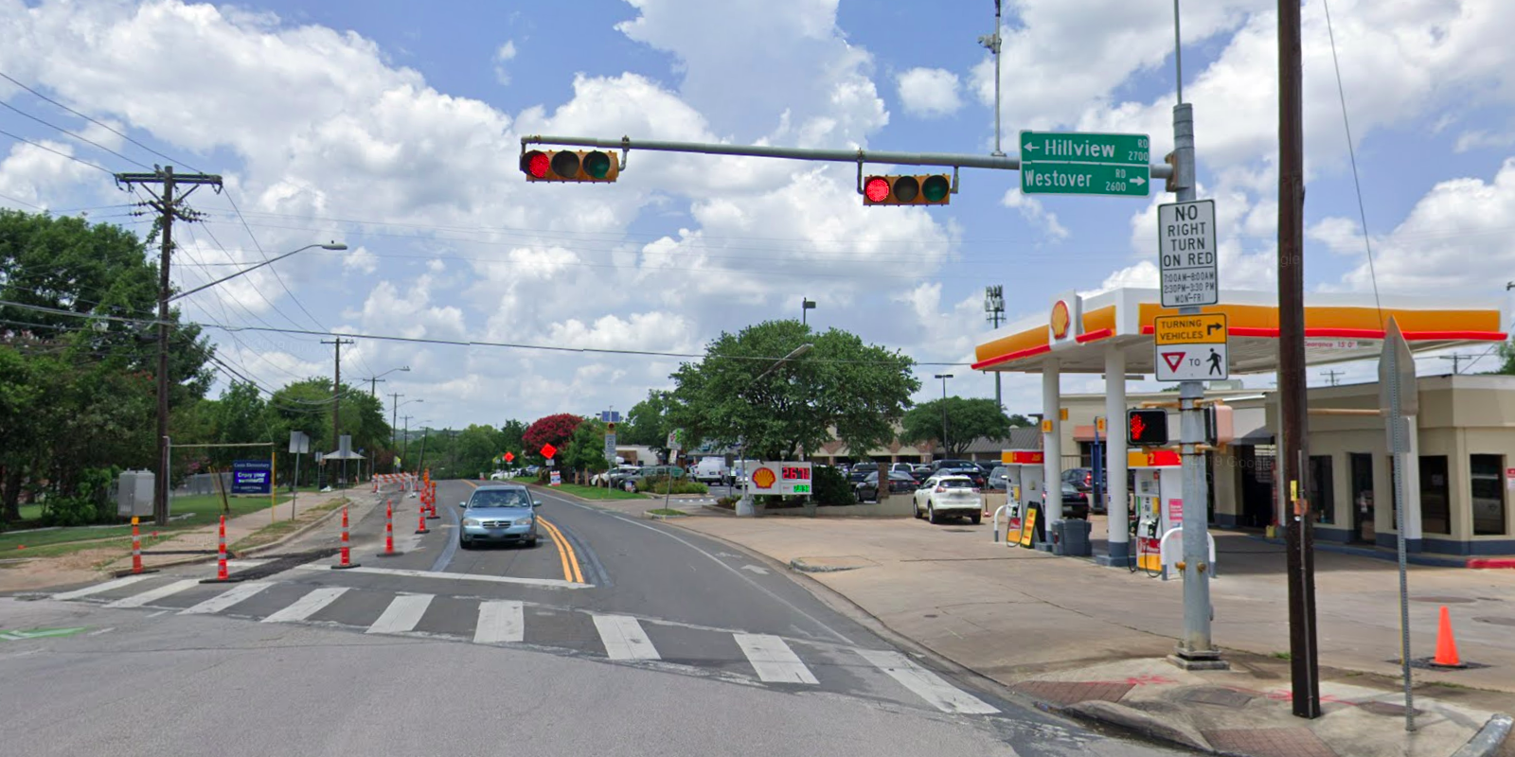
Austin Transportation Department Signs Work Orders
Created By: Susanne Gov Created Date: 2020-05-21 Location Name: EXPOSITION BLVD / WESTOVER RD Intersection ID: 5153874 Cardinal Direction: N
Sign Type | Install/Remove
Street Name Sign | Install
No Right Turn On Red | Install
Turning Vehicle Yield To Ped Symbol | Install
Schedule | Install

Slide 2
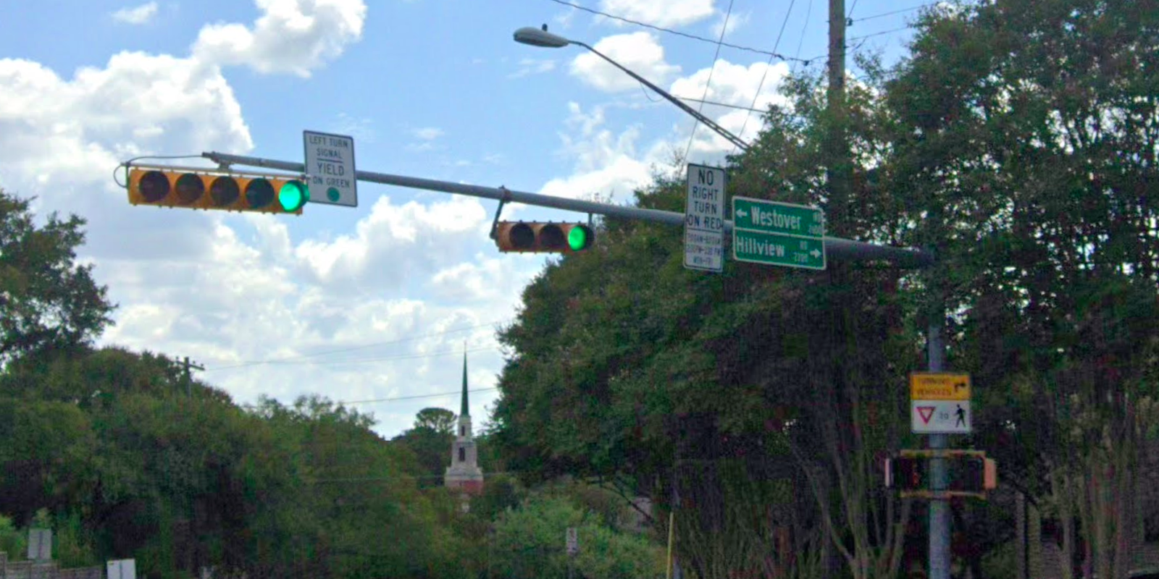
Austin Transportation Department Signs Work Orders
Created By: Susanne Gov Created Date: 2020-05-21 Location Name: EXPOSITION BLVD / WESTOVER RD Intersection ID: 5153874 Cardinal Direction: S
Sign Type | Install/Remove
Left Turn Yield On Green | Install
Street Name Sign | Install
No Right Turn On Red | Install
Turning Vehicle Yield To Ped Symbol | Install
Schedule | Install

Slide 3
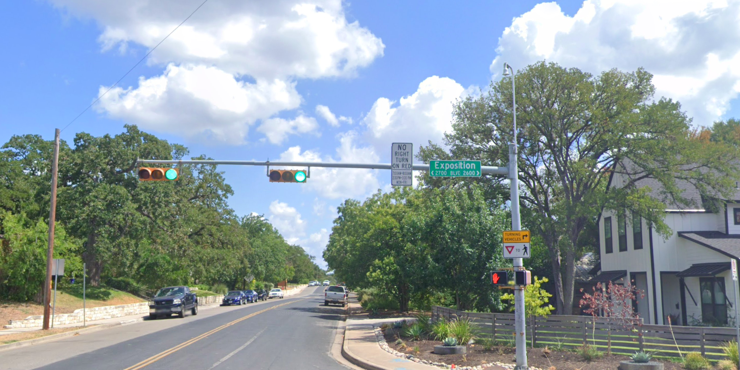
Austin Transportation Department Signs Work Orders
Created By: Susanne Gov Created Date: 2020-05-21 Location Name: EXPOSITION BLVD / WESTOVER RD Intersection ID: 5153874 Cardinal Direction: E
Sign Type | Install/Remove
Street Name Sign | Install
No Right Turn On Red | Install
Turning Vehicle Yield To Ped Symbol | Install
Schedule | Install

Slide 4
Austin Transportation Department Signs Work Orders
Created By: Susanne Gov Created Date: 2020-05-21 Location Name: EXPOSITION BLVD / WESTOVER RD Intersection ID: 5153874 Cardinal Direction: W
Sign Type | Install/Remove
Street Name Sign | Install
No Right Turn On Red | Install
Turning Vehicle Yield To Ped Symbol | Install
Schedule | Install

